Slide 1

FACE RECOGNITION in Video using face_recognition and opencv libraries
Name: Darshan Surana
ID: 190040109

Slide 2
ABSTRACT
The purpose of this project is to make facial recognition (identifying a face) simple in real time.
Whether it's for security, smart homes, attendance system, or something else entirely, the area of application for facial recognition is quite large.
The idea in this project is to identify the unknown faces in real time from already known labeled faces. If no unknown face is matched to any known labeled faces, then it should output as UNKNOWN else it should output as label of matched photo.
Also, the matching of photo is controlled by TOLERANCE. The default tolerance value is 0.6 and lower numbers make face comparisons stricter. The lower the tolerance the less chance you must get false positive and if tolerance is less then matching will be stricter and there will be high probability of getting more false negative.

Slide 3
ABSTRACT
As there can be many known faces so it can be difficult to store all the known faces in the folder. So whenever a unknown face comes, the unknown face will be stored with a particular ID, so again if that unknown face comes then it will recognized with that ID.
This makes faces recognition more efficient.

Slide 4
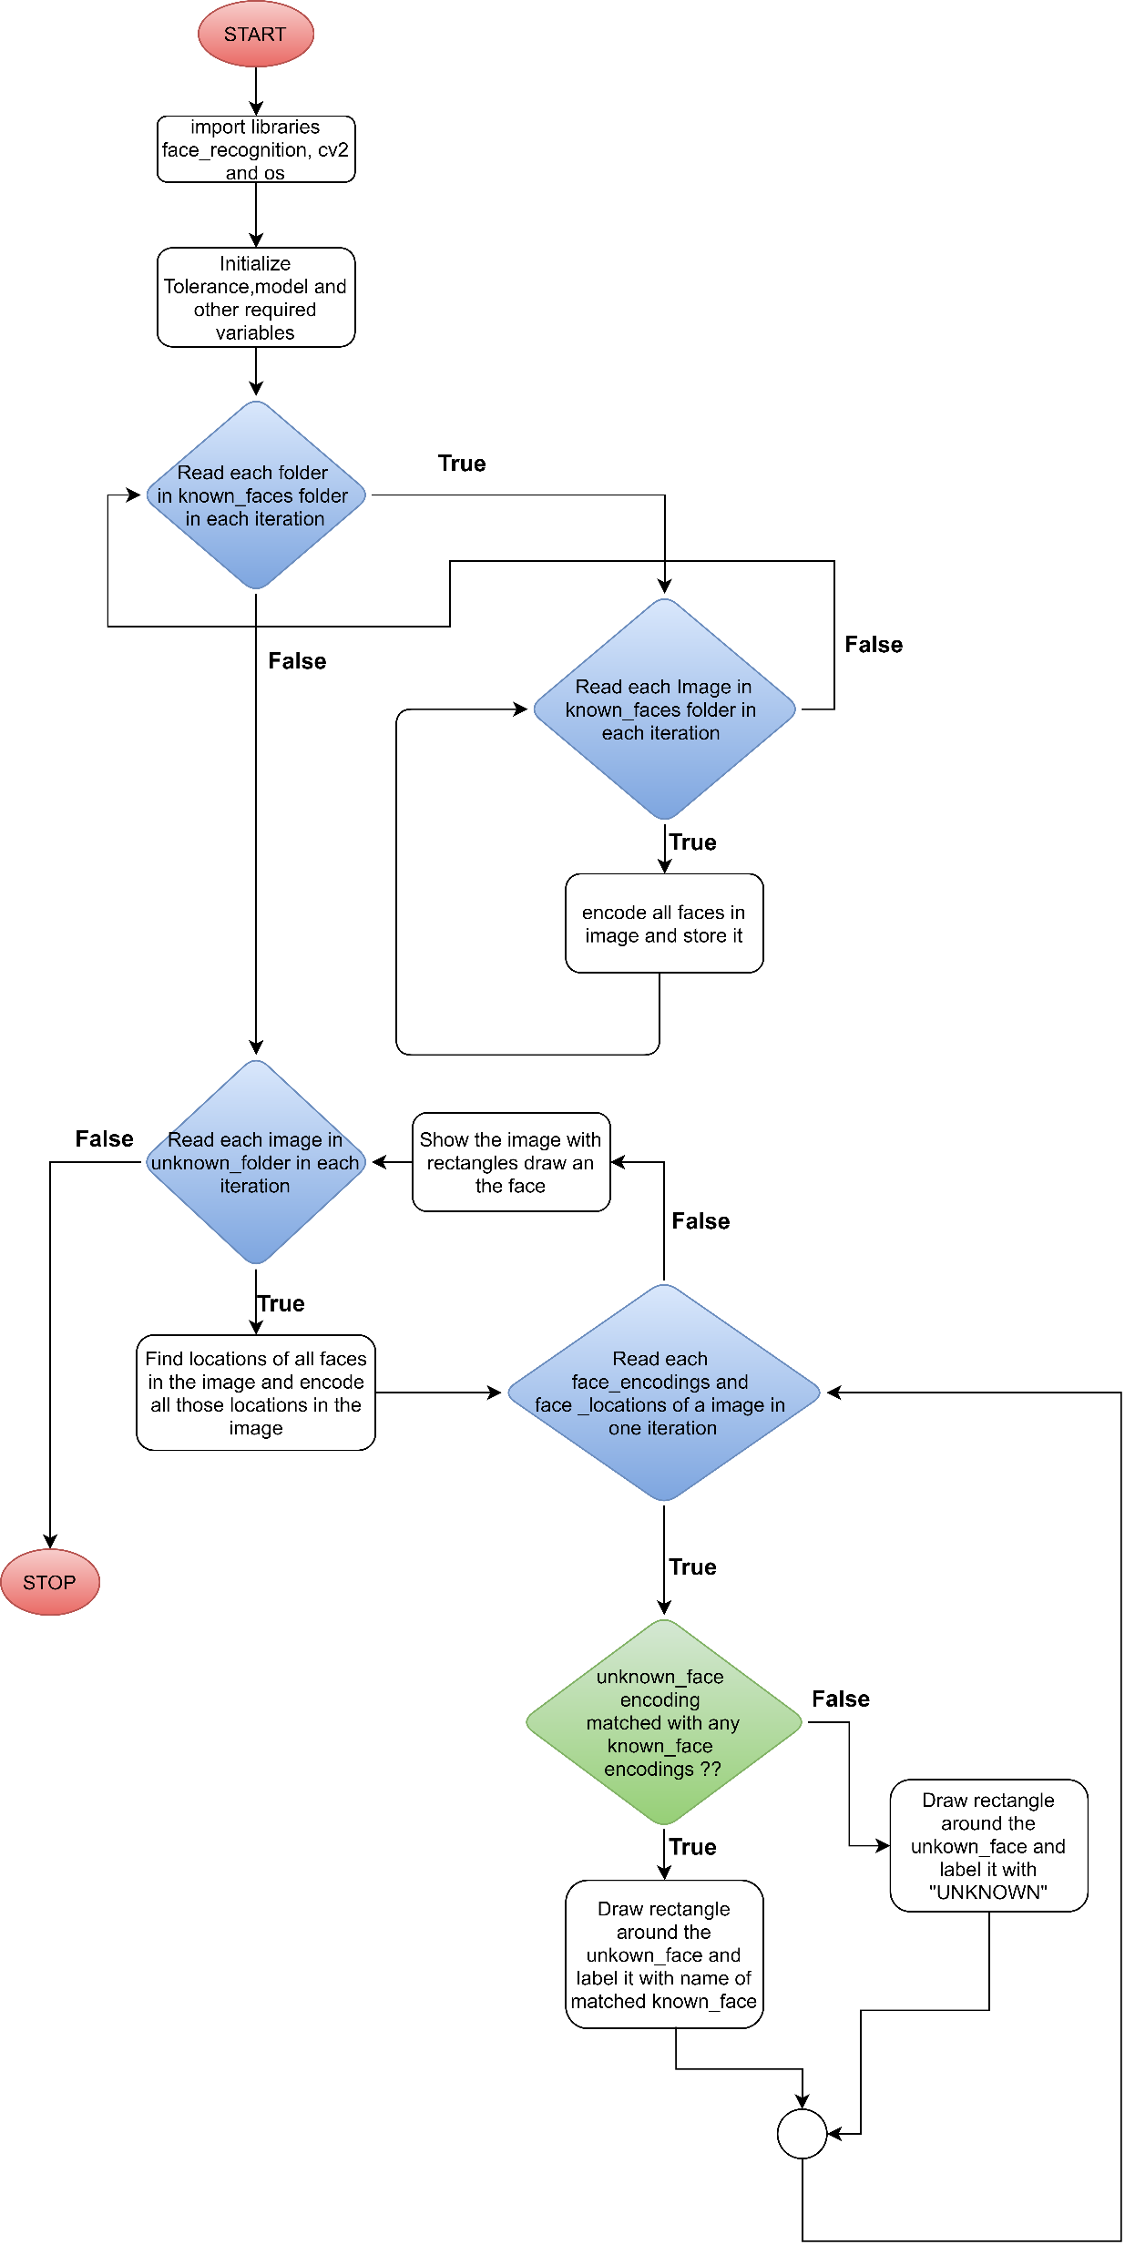
FLOW CHART

Slide 5

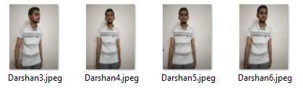
INTRODUCTION
The project folder has one folder
Inside known_faces folder there is folder for each person and folder name is person name.
Darshan folder has these images

Slide 6
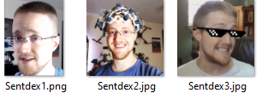
INTRODUCTION
Sentdex folder has these images

Slide 7
HOG
HOG, or Histogram of Oriented Gradients, is a feature descriptor that is often used to extract features from image data.
It is widely used in computer vision tasks for object detection.
The HOG feature descriptor counts the occurrences of gradient orientation in localized portions of an image.

Slide 8
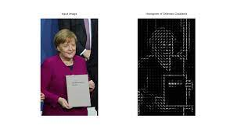
HOG

Slide 9
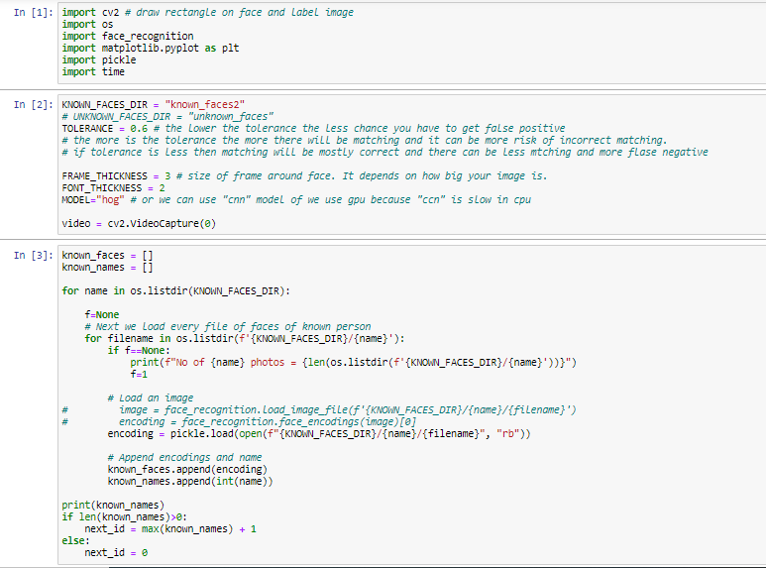
CODE

Slide 10
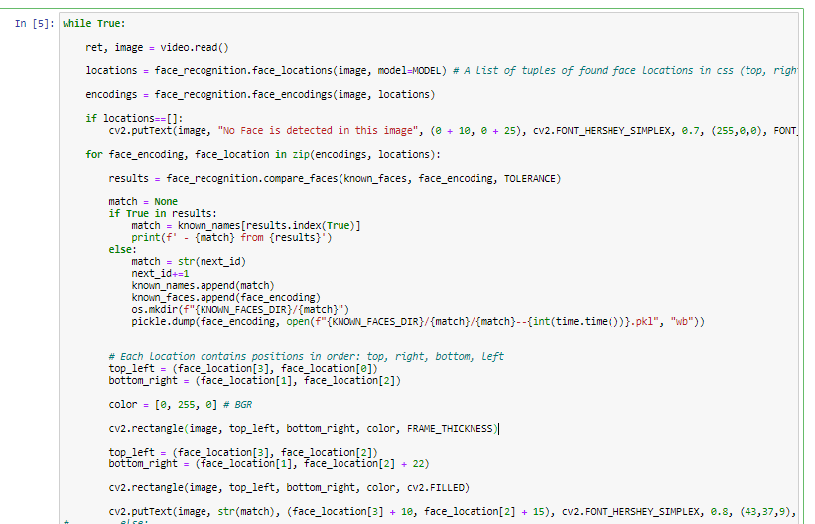
CODE

Slide 11
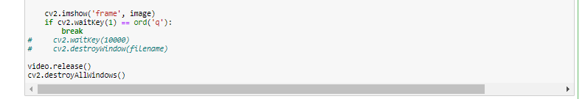
CODE

Slide 12
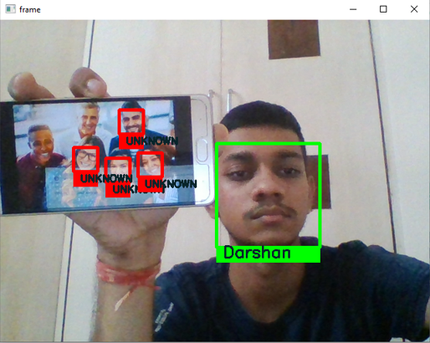
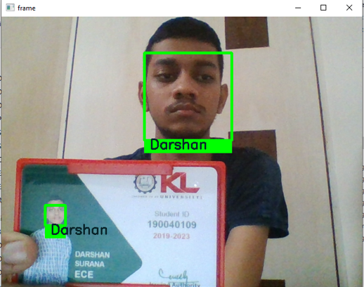
OUTPUT

Slide 13
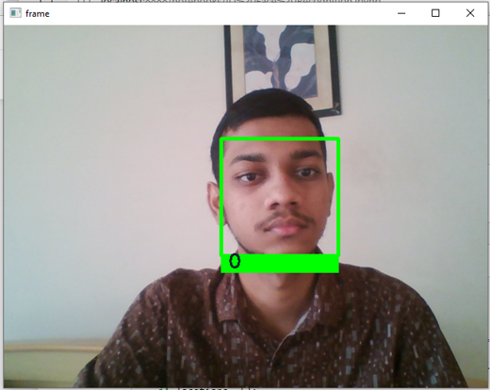
OUTPUT
In this program initially no known faces are stored whenever a unknown face comes the program assigns a ID to that face and next time whenever that faces comes the faces is recognized with that ID.

Slide 14
CONCLUSION
We should select optimal value of tolerance so that both false positive and false negative are minimum.
Face recognition can be used in Smarter Advertising.
Face recognition can be used to find missing children and victims of human trafficking.
Face recognition can be used to Track School Attendance.
Face recognition can be used to Control Access To Sensitive Areas.

Slide 15
THANK YOU

